Slide 1
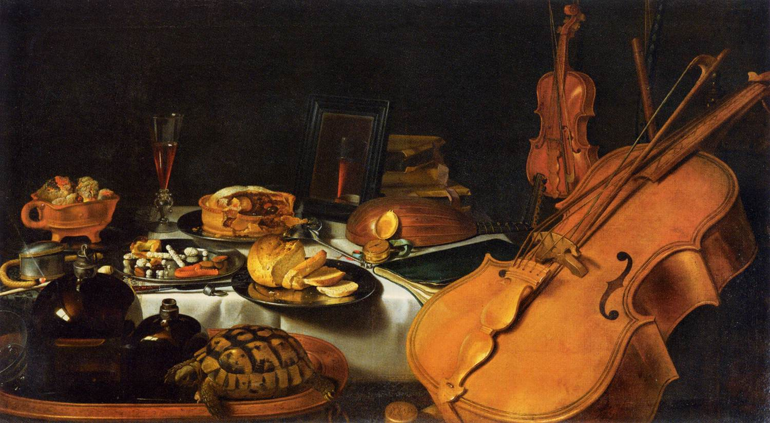

Sensation & Perception
[Class Section Number]
[Instructor Name]
Notes:
Classrooom Recommendations: Sensation & Perception is ideally taught over 2-class periods. It will likely be the case that almost an entire day is devoted to vision. Many students find this section to be the most interesting and there exist a variety of great demonstrations to illustrate some of the core concepts. If this is the case, it is fairly doable to cover the rest of the senses in a single day.
Overview: The topics of sensation and perception are among the oldest and most important in all of psychology. People are equipped with senses such as sight, hearing and taste that help us to take in the world around us. Amazingly, our senses have the ability to convert real-world information into electrical information that can be processed by the brain. The way we interpret this information-- our perceptions-- is what leads to our experiences of the world. In this module, you will learn about the biological processes of sensation and how these can be combined to create various perceptions.
Warmup discussion: Ask the class which sense they would be willing to give up, if they had to. Try and find students that would be willing to give up a few different senses and build a discussion around how their world would be different.
Technical Note: These slides may contain simple click animation so that you can focus students’ attention on a particular question, a selection of text, or an image and not have them be distracted by reading ahead. You can either preview the sequence of animation by going through the slides in slideshow view, visiting the animations tab, or reviewing the slide notes. In the notes you will see a cue - (Click) – that corresponds to each animation.
You may also find hyperlinks to outside videos at various places in the slides. These hyperlinks are embedded in text and indicated by color and in the notes section.

Slide 2
Overview
Basic Concepts
Vision
Hearing
Touch
Smell and Taste
Multimodal Perception
Notes:
The purpose of this slide is to provide students with an overview of the material that will be covered during the lecture.

Slide 3
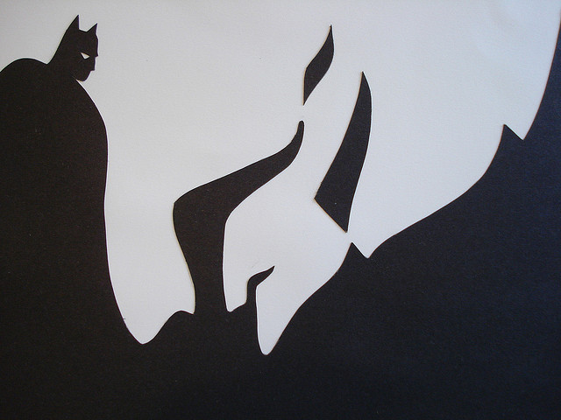
Sensation vs. Perception
Notes:
This slides helps illustrate the difference between sensation and perception.
Instructor’s note: Explain to the class the difference between sensation and perception. This can be demonstrated by asking students to discuss what they perceive in the images on the slide. Do the students first see the hero in the burning building, or the face of the villain? While the sensation provided is identical for all students looking at the image, the perception of what is being shown differs individually.
Discussion question: Are there any bands you listen to that your friends don’t like? Is music preference a matter of sensation or perception?
Possible Answer: While the auditory stimulus is the same, our perception of different music is what results in us liking something that other might not like.

Slide 4
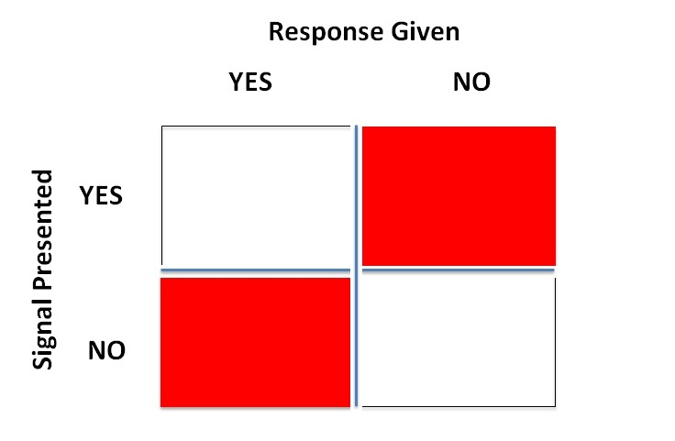
Signal Detection
HIT
MISS
FALSE
ALARM
CORRECT
REJECTION
Notes:
This slide covers the outcomes of a study looking at signal detection and what we can learn from them.
Instructor’s note: The matrix above presents the four outcomes that can occur when you are studying whether or not a research participant/subject can detect a signal in a sensory modality. Explain to the class that a signal is presented or not and that a participant either indicates they detected the signal or not (this is very similar to what occurs during a hearing test, an experience that many students will be familiar with). The outcomes in the four quadrants will reveal themselves with each click. The instructor can lead the class down the path of naming each one when presented with the descriptions below:
A signal is presented and the participants gives a response.
(Click) Hit
A signal is presented and the participant does not give a response.
(Click) Miss
A signal is not presented and the participant gives a response.
(Click) False alarm
A signal is not presented and the participant does not give a response.
(Click) Correct rejection
Discussion question: What kind of information can we get from signal detection studies?
Possible Answer: These signal detection studies allow us to assess things like the absolute threshold of a sensory modality as well as the differential threshold and the effects of sensory adaptation. To help students digest these concepts, please refer to the examples of the aforementioned phenomena in the module or come up with your own. You can also solicit examples of these phenomena from the students to gage how much of this material they have retained.

Slide 5
Sensation Perception
I
LOVE
PARIS IN THE
THE SPRINGTIME
Notes:
This slide covers the difference between bottom-up and top-down processing. The arrow between the two words in the title is supposed to represent how sensation and perception can influence one another.
Demonstration: Asking a student to read what is written in the triangle out loud will normally result in a coherent sentence being recited.
Discussion question: Why will many people miss the additional “the” in the sentence printed in the triangle? Are we processing every word separately when we read sentences?
Possible Answer: When we read something, we have an expectation of what we will see because of our knowledge of grammar. This expectation can influence what we actually perceive through top-down processing.
Discussion question: What are other real world examples of when bottom-up or top-down processing occur?
Possible Answer: When a child is learning how to read, they are relying primarily on bottom-up processing while a seasoned reader would rely more on top-down processing.

Slide 6
Overview
Basic Concepts
Vision
Hearing
Touch
Smell and Taste
Multimodal Perception
Notes:
The purpose of this slide is to provide students with an overview of the material that will be covered during the lecture.

Slide 7
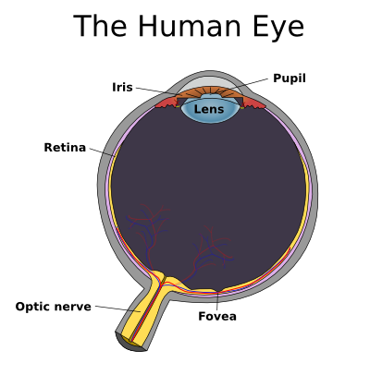
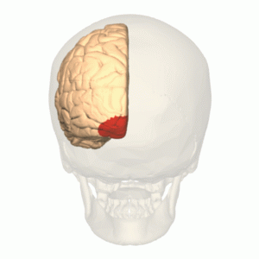
Vision
Primary visual cortex
Notes:
This slide describes the sense of vision and what it accomplishes.
Instructor’s note: Give students a brief overview of how light enters the pupil and gets converted into electrical signals by rods and cones in the retina in the back of the eye. Cover the difference in function between the rods and the cones. The fact that we have two eyes present our brain with two slightly different images, a phenomenon called binocular disparity. Describe the sending of information to the primary visual cortex.
Activity: Have students hold a pen in their hand, extend their arm in front of their face and look at it with each eye individually. Ask them pay attention to the apparent position of the pen relative to objects in the background. Depending on which eye is open the pen appears to jump back and forth! This demonstrates binocular disparity.

Slide 8
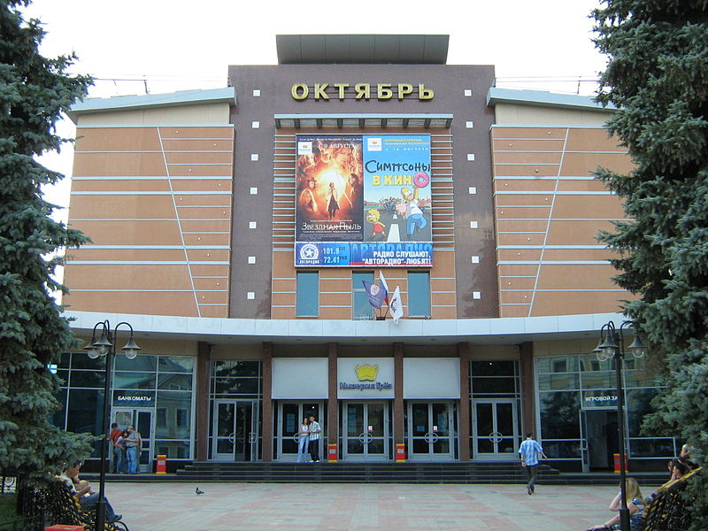

Dark & Light Adaptation
Dark inside
Bright outside
Notes:
This slide covers some phenomena that occur when we change between environments with drastically different amounts of light.
Instructor’s note: Ask the class to reflect on the experience of seeing a movie during the daylight hours.
(Click) Dark inside
Discussion question: What happens to your vision when you walk into a movie theater on a sunny day?
Possible answer: You can’t really see anything for a few minutes.
Further discussion: Ask students to consider what is happening at the level of the photoreceptors when it comes to this experience. What kind of stimulation are they receiving prior to entering the dark theatre? What about after entering it?
(Click) Bright outside
Discussion question: After leaving the theatre and heading back outside, what happens?
Possible answer: Everything appears washed out and your eyes hurt for a few seconds.
Further discussion: Just like with the last example, have the students consider what kind of stimulation is being received prior to leaving the theatre as well as immediately upon stepping outside. Have the focus be at the level of the photoreceptors.
Explanation: When moving into a dark environment, rods must become more activated, a process that can take up to 30 minutes to occur. This explains why at first you may not be able to see in a movie theatre, but after a few moments you begin to see objects around you more clearly. As to the reasons why your eyes might hurt once you step out of a dark environment into the light, is because the muscles around your pupil will contract making it smaller as to avoid being blinded by brightness. In this scenario you are also switching from rods to cones and it takes time to turn off a great number of the former and to activate the latter.

Slide 9
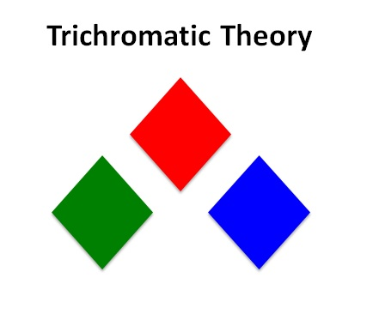
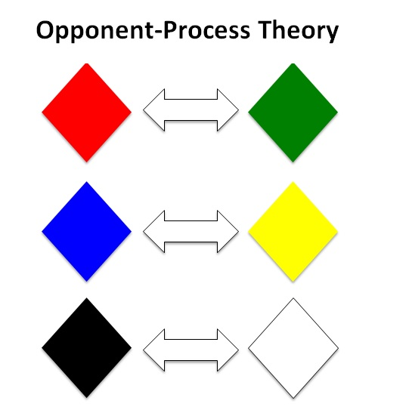
Color Vision
Notes:
This slide illustrates the principle of color and how it is perceived.
Instructor’s note: Begin by describing the two theories and the fundamental differences between the two. Trichromatic Theory states that our cones have a preference for 3 kind of colors – red, green, and blue. While Opponent-Process Theory postulates that our cones (or rather the retinal ganglion cells that receive the information from our cones) respond to pairs of colors – red-green, blue-yellow, black-white.
Discussion question: If we only have 3 kinds of cones, how are we able to see is so many colors?
Possible answer: Combinations of different light provide us with the ability to see a variety of different colors.
Further discussion: If the combination of activity from 3 kinds of cones provides us with the ability to see all colors, why aren’t we able to see certain “impossible” colors (e.g. bluish yellow or reddish green)?
Explanation: The impossible colors exist because our cones are arranged in an opponent-process manner. Elaborate on what this means – the retinal ganglion cells that were mentioned before are taking color-based information from the cones and are “computing” the difference between the two, so we cannot see a bluish yellow or a reddish green color.
Instructor Note about the slides 10-13 that come next. Let the students know that now they are going to be able to see some examples of color perception.

Slide 10
Notes:
This slide demonstrates the concept of the opponent process theory.
Instructor’s note: Tell students to look at the center of the plus in the middle of the rectangle.
After 30 seconds to one minute (Click)

Slide 11
Notes:
This slide allows students to see the after image from the previous slide.
Instructor’s note: Ask students what color image they see now. They will likely see a green rectangle with a yellow plus in the center.

Slide 12
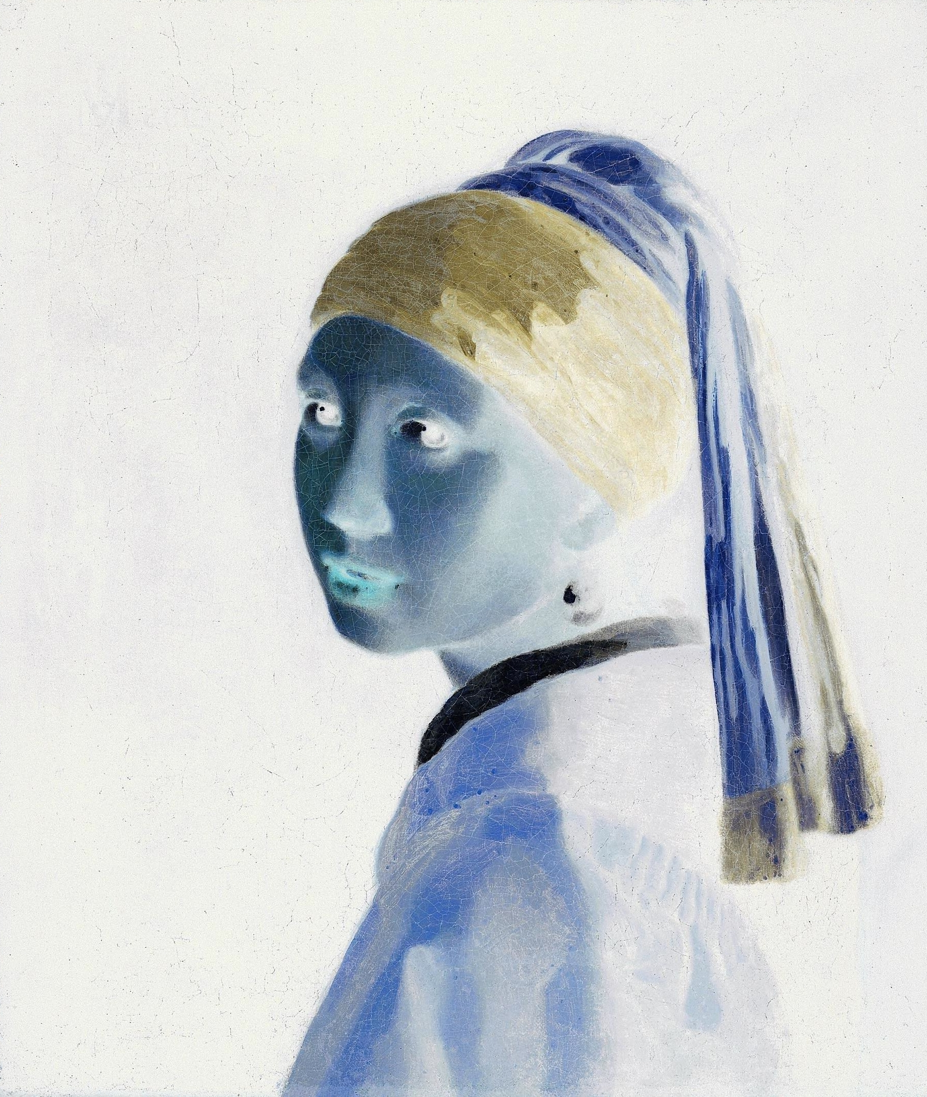
Notes:
This slide demonstrates the concept of the opponent process theory.
Instructor’s note: Tell students to look at the center of image.
After 30 seconds to one minute (Click)

Slide 13
Notes:
This slide allows students to see the after image from the previous slide.
Instructor’s note: Ask students what color image they see now. They will likely see a full color image that is composed of a more natural color scheme (e.g. darker background, the color of the woman’s jacket changes to dark mustard, while her headband changes to blue).

Slide 14
Overview
Basic Concepts
Vision
Hearing
Touch
Smell and Taste
Multimodal Perception
Notes:
The purpose of this slide is to provide students with an overview of the material that will be covered during the lecture.

Slide 15
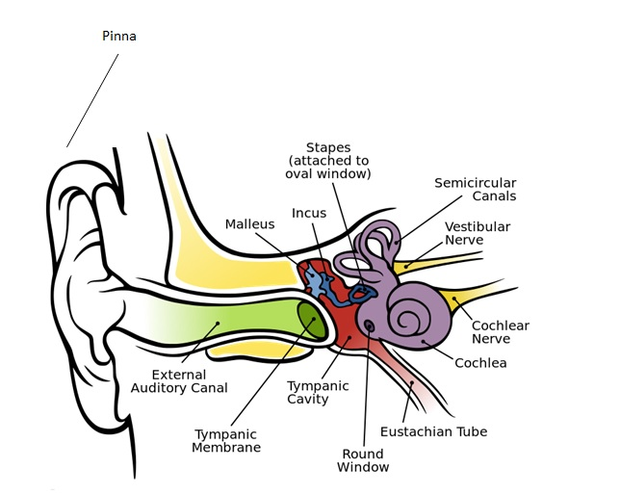
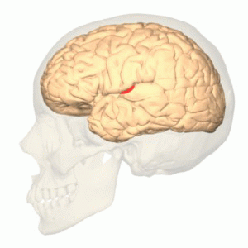
Hearing
Primary auditory cortex
Notes:
This slide describes the sense of hearing and what it accomplishes.
Instructor’s note: Give students a brief overview of how sound waves enter the auditory canal after being funneled by the pinna, vibrating the tympanic membrane and ossicles before reaching the cochlea. Explain the role of auditory hair cells in the conversion of sound waves into electrical signals. Describe the sending of the information to the primary auditory cortex. You might also want to use this opportunity to bring up the additional function of parts of the cochlea that comprise the vestibular system.
Demonstration: Ask students to pair up and hold a conversation with each other. During this conversation, have the students manipulate their pinnae by folding them into different positions.
Discussion prompt: Describe what you experienced during your conversation when you were manipulating you pinnae.

Slide 16
Overview
Basic Concepts
Vision
Hearing
Touch
Smell and Taste
Multimodal Perception
Notes:
The purpose of this slide is to provide students with an overview of the material that will be covered during the lecture.

Slide 17
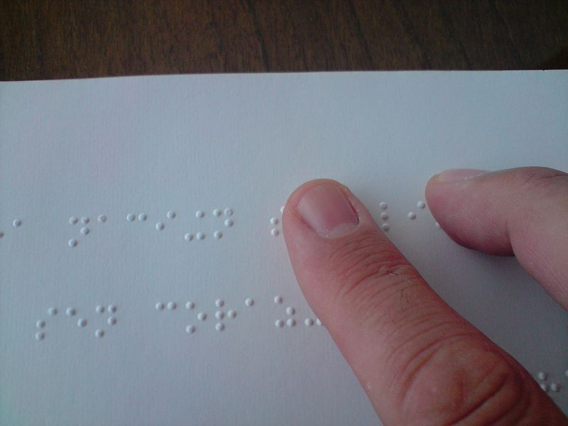
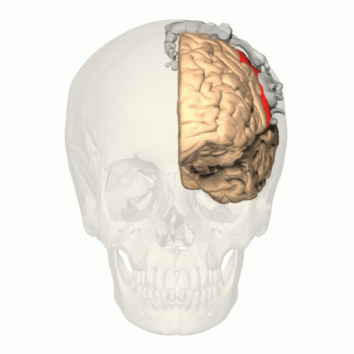
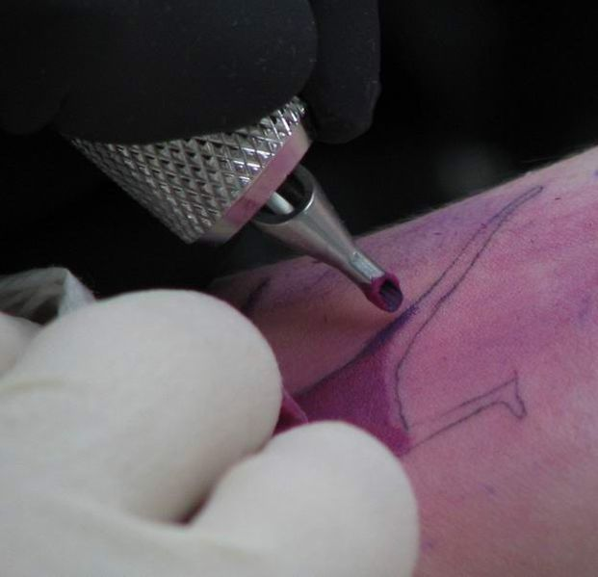
Touch
Primary somatosensory cortex
Notes:
This slide describes the sense of touch and what it accomplishes.
Instructor’s note: Give students a brief overview of how different tactile stimuli are processed and how touch can give us the ability to appreciate the subtle bumps on a sheet of paper while reading braille as well as the sharp pain of a tattoo machine stabbing our skin hundreds of thousands of times. Differentiate between the different stimuli processed by the skin.
Discussion question: How does the brain code for body areas that are more sensitive than others?
Possible answer: Possible answer: Areas of the body that are more sensitive account for more primary somatosensory cortex than less sensitive areas. This is represented on the somatotopic map illustrated in the module as well as the animation on the slide.
Discussion question: What would happen if the input from a limb to the primary somatosensory cortex was destroyed through amputation?
Possible answer: The person experiencing the amputation may experience the sensation that the missing limb is still there. This phenomenon is called phantom limb.
Phantom Limb Video (8:84) https://www.youtube.com/watch?v=1mHIv5ToMTM
Instructor’s note: Open up a discussion of what phantom limb and phantom limb pain are as well as the proposed explanation for their existence (some of this information is discussed in detain in the video itself). Possibly ask students to propose treatments for the treatment of phantom limb pain. One possible answer might be Mirror Therapy – developed by Ramachandran. Find more information on it here: http://www.physio-pedia.com/Mirror_Therapy

Slide 18
Overview
Basic Concepts
Vision
Hearing
Touch
Smell and Taste
Multimodal Perception
Notes:
The purpose of this slide is to provide students with an overview of the material that will be covered during the lecture.

Slide 19
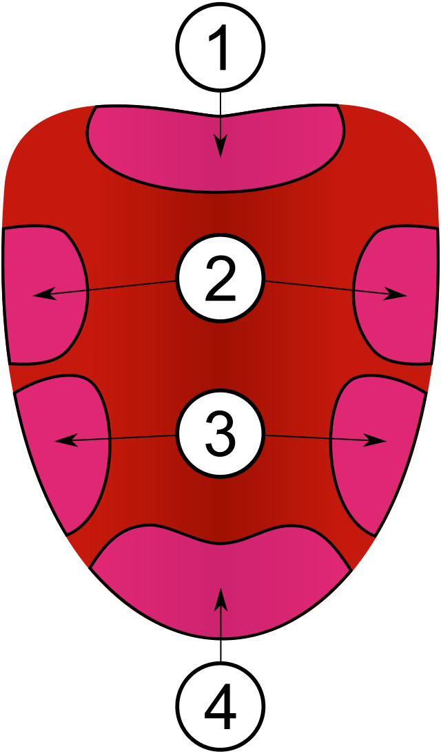
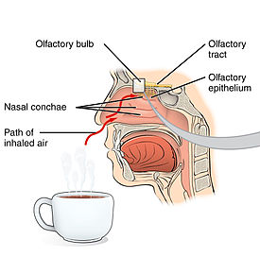
Smell and Taste
Notes:
This slide describes the senses of smell and taste.
Instructor’s note: Give students a brief overview of how chemicals from the environment (odorants and tastants respectively) bind to their corresponding receptor cells in order to have the signal converted to an electrical signal that the brain can understand. Poll the class to see if anyone has experienced anosmia due to a car accident or other form of physical trauma to open a discussion of why this phenomenon happens to people after head trauma. Slide presents both senses together in order to provide the opportunity to discuss the combination of smell and taste: flavor.
Explanation: Olfactory receptor send information through axons that pass through the cribriform plate of the skulls. Head trauma has the potential to destroy these connections resulting in temporary anosmia. Luckily, the sense of smells comes back after a few months in most cases.
Discussion question: How many tastes are there are how does the diagram on the right illustrate how the tongue processes them?
Possible answer: The tongue is organized into a map that processes the five different kinds of taste (i.e. sweet, sour, bitter, salty, umami).
(Click) Picture of the tongue map is crossed out.
Explanation: The idea that the tongue is organized into a map has been falsified through additional research. Furthermore, the number of tastes isn’t completely agreed on yet but likely also includes the ability to taste fatty acid.
Discussion question: What are the bumps on the tongue called?
Incorrect Possible answer: The bumps on the tongue are called taste buds. This is incorrect and a common misconception among students. The bumps are called papillae, not taste buds. Taste buds are actually found in the divots between papillae and contain taste receptor cells.
Demonstration: After discussing the two sense separately, a demonstration can be done in order to provide the experience of flavor for discussion. This can be accomplished by bringing a small bag of candy to class and handing pieces out to individual students.
Ask students to pinch their nose closed and insert the piece of candy into their mouth.
Have them begin to chew the candy with their nose still plugged and explain to them that they are experiencing the sense of taste alone.
Tell students to release their nose and explain that they are now getting the additional sense of smell in combination with the taste to experience flavor.
Discussion prompt: Describe what you experienced before and after releasing your nose while chewing the candy.

Slide 20
Overview
Basic Concepts
Vision
Hearing
Touch
Smell and Taste
Multimodal Perception
Notes:
The purpose of this slide is to provide students with an overview of the material that will be covered during the lecture.

Slide 21
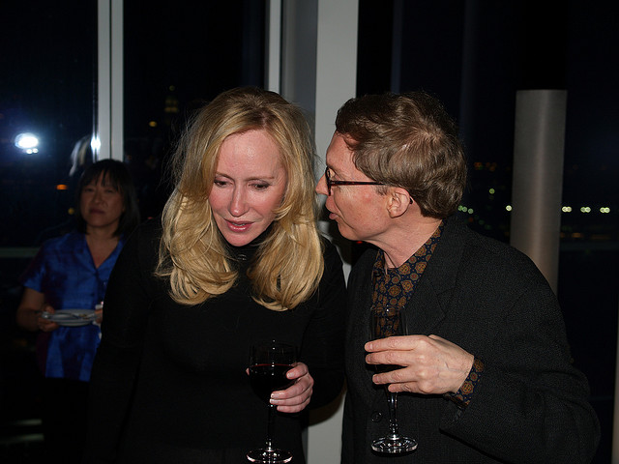
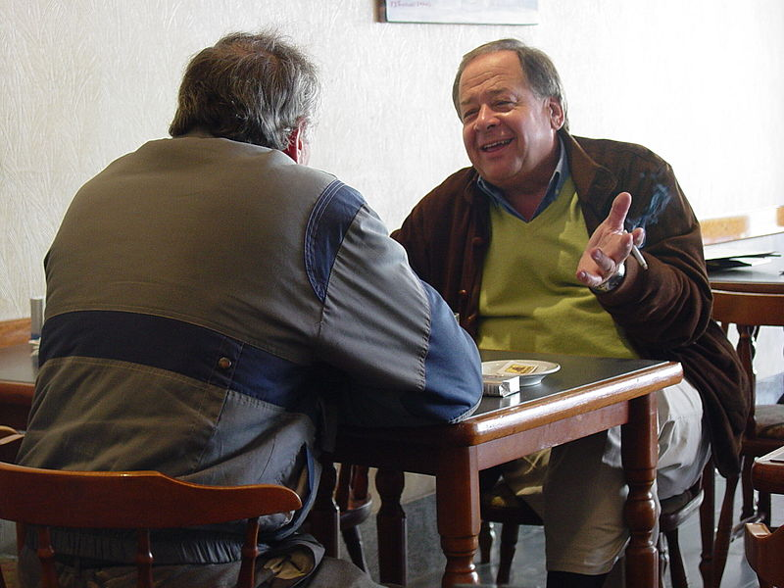
Multimodal Perception
Principle of inverse effectiveness
Superadditive effect of multisensory integration
Notes:
This slide describes multimodal perception.
Instructor’s note: Describe how most of our sensory experiences are actually multimodal. Most students will need some help recognizing this because they likely have only covered the senses independently up to this point (see below).
Discussion question: When you are at a loud concert or party, how are you able to hold a conversation with a friend?
Possible answer: You are not limited to only hearing your friend at a concert. Paying attention to your friend visually will provide additional cues that add together to allow you to know what is being said.
Instructor’s note: Multimodal perception can be pretty hard for students to immediately understand until you provide more real-world examples for them.
(Click) Superadditive effect of multisensory integration
Explanation: The concept example from above is a great way for students to reflect on the superadditive effect of multisensory integration. They are able to understand what their friend at the concert is saying because they are getting information from more than one sense (in this case, vision and hearing).
(Click) Principle of inverse effectiveness.
Explanation: This effect would likely not benefit you in a quiet café as predicted by the principle of inverse effectiveness. A more relaxed volume of voice would likely be sufficient to hear your friend if you were chatting back and forth.
Demonstration: Other multimodal phenomena can be illustrated with the following videos:
McGurk Effect Video (3:25) https://www.youtube.com/watch?v=G-lN8vWm3m0
The Rubber Hand Illusion (3:12) https://www.youtube.com/watch?v=sxwn1w7MJvk
Double Flash Illusion (:45) https://vimeo.com/39138252

Slide 22
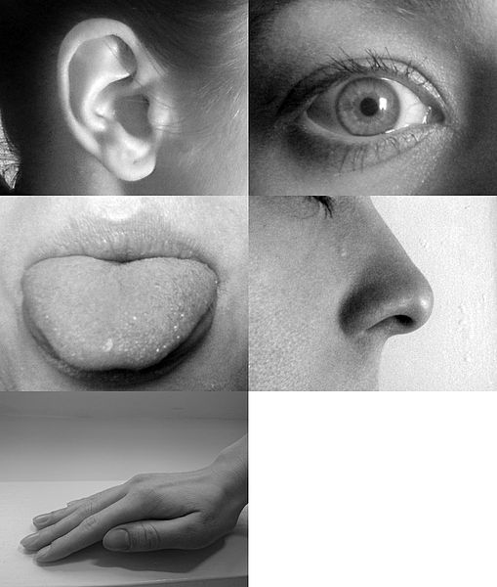
Conclusion
Notes:
This slide allows for a summary discussion of sensation and perception.
Instructor’s note: Depending on how much time you plan on using to cover this topic, there are additional videos and resources that can generate some good discussion among your class.
Cybersenses Video (26:20) https://www.youtube.com/watch?v=_8rPD6xLB4A
Discussion question: Are there any reason why people might not want to restore a lost sense?
Possible answer: Members of the deaf community sometimes show no interest in restoring their missing hearing. The explanations for this choice are many.
Seeing Sound, Tasting Color Video (2:32) https://www.youtube.com/watch?v=FTr1VnXKr4A
Instructor’s note: This video briefly introduces the interesting topic on synesthesia. After showing the video, poll the class to see if anyone experiences this phenomenon. If you are lucky enough to have a synesthete in your class, ask them to elaborate on their experience for the class. Afterword, or in the event you don’t have any, use the following activity:
Activity: Illustrate that anyone can potentially experience synesthesia by using the Bouba-Kiki Effect demonstration http://www.sciencebuddies.org/science-fair-projects/project_ideas/HumBeh_p026.shtml#summary
Explanation: Most students will name the sharp shape Kiki and the smooth one Bouba. Researchers think that this might be because the shapes look like how the names sound. Additionally, your mouth feels smoother when saying one name and sharper for the other. This is a crossing of sensory modalities and potentially a way to give everyone the experience of synesthesia.

Slide 23
Photo Attribution
Slide 1 | Photo Credit: Mattes https://commons.wikimedia.org/wiki/File:Claesz,_Pieter_-_Still-Life_with_Musical_Instruments_-_1623.jpg http://creativecommons.org/publicdomain/zero/1.0/deed.en
Slide 3 | PhotoCredit: eyez2theskiez https://www.flickr.com/photos/cjolson/1591829251/ https://creativecommons.org/licenses/by-nc-sa/2.0/
Slide 7 | Photo Credit: CFCF https://commons.wikimedia.org/wiki/File:1423_Retinal_Disparity.jpg https://creativecommons.org/licenses/by/3.0/
Slide 7 | Photo Credit: Was a bee https://commons.wikimedia.org/wiki/File:BA17_Primary_visual_cortex_-_animation.gif https://creativecommons.org/licenses/by-sa/2.1/jp/deed.en
Slide 8 | Photo Credit: Vmenkov https://commons.wikimedia.org/wiki/File:NNov-B-Pokrovskayta-Oktyabr-movie-theatre-C0518.jpg https://creativecommons.org/licenses/by/3.0/
Slide 8 | Photo Credit: yellow smiley sun with sunglasses 7 cm Cathy https://www.flickr.com/photos/bycp/5612802943 https://creativecommons.org/licenses/by-nc/2.0/
Slide 12 | Photo Credit: Negative version of Girl with a Pearl Earring (1660s) by Johannes Vermeer- negative https://commons.wikimedia.org/wiki/File:Johannes_Vermeer_-_Girl_with_a_Pearl_Earring_(1660s)_-_negative.jpg#/media/File:Johannes_Vermeer_-_Girl_with_a_Pearl_Earring_(1660s)_-_negative.jpg Public Domain
Slide 15 | Photo Credit: Mike.lifeguard https://commons.wikimedia.org/wiki/File:Anatomy_of_the_Human_Ear_en.svg https://creativecommons.org/licenses/by/2.5/
Slide 15 | Photo Credit: Was a bee https://commons.wikimedia.org/wiki/File:Primary_auditory_cortex_-_animation.gif https://creativecommons.org/licenses/by-sa/2.1/jp/deed.en
Slide 17 | Photo Credit: אריה_ה https://commons.wikimedia.org/wiki/File:A_person_reading_a_braille_book.jpg https://creativecommons.org/licenses/by-nc-sa/2.0/
Slide 17 | Photo Credit: Liftarn https://commons.wikimedia.org/wiki/File:TattooInProgress.jpg http://creativecommons.org/publicdomain/zero/1.0/deed.en
Slide 17 | Photo Credit: Was a bee https://commons.wikimedia.org/wiki/File:BA312_-_Primary_Somatosensory_Cortex_-_with_homunculus.gif https://creativecommons.org/licenses/by-sa/2.1/jp/deed.en

Slide 24
Photo Attribution
Slide 19 | Photo Credit: OpenStax College https://commons.wikimedia.org/wiki/File:1403_Olfaction.jpg https://creativecommons.org/licenses/by/3.0/
Slide 19 | PhotoCredit: MesserWoland https://en.wikipedia.org/wiki/Tongue_map#/media/File:Taste_buds.svg https://creativecommons.org/licenses/by/2.5/
Slide 21 | Photo Credit: Last Roll - 053.jpg Art Comments https://www.flickr.com/photos/52072922@N00/2363242669/ https://creativecommons.org/licenses/by/2.0/
Slide 21 | Photo Credit: Adam63 https://commons.wikimedia.org/wiki/File:Cafe_Life_in_Tigre_-_Near_Buenos_Aires_-_Argentina.JPG https://creativecommons.org/licenses/by/3.0/ Photo by Adam Jones adamjones.freeservers.com
Slide 22 | Photo Credit: Allan-Hermann Pool https://commons.wikimedia.org/wiki/File:Five_senses.jpg https://creativecommons.org/licenses/by-sa/4.0/deed.en

